Slide 1

EEG EYE STATE CLASSIFICATION
MATHEMATICS IN MACHINE LEARNING
GIANVITO LITURRI
A.A. 2021/2022

Slide 2
DATA EXPLORATION
1

Slide 3
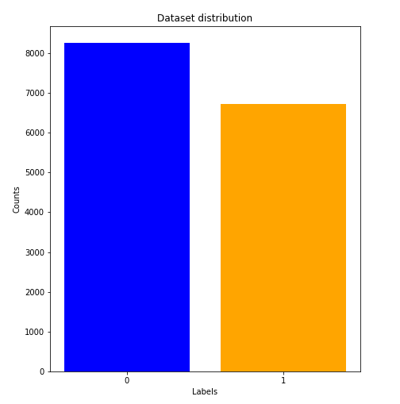
OVERVIEW
The dataset consists in 14980 records, each of them is characterized by 14 EEG measurements from the headset, originally labeled:
AF3
F7
F3
FC5
T7
P
O1
O2
P8
T8
FC6
F4
F8
AF4
All features are numerical.

Slide 4
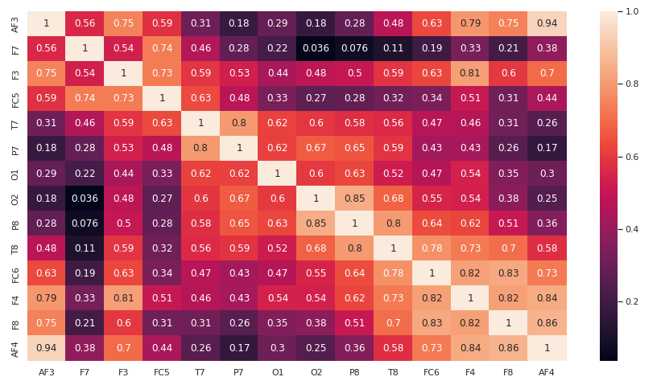
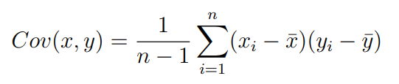
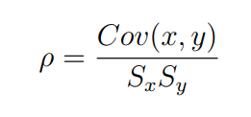
CORRELATION MATRIX

Slide 5
DATA PREPARATION
2

Slide 6
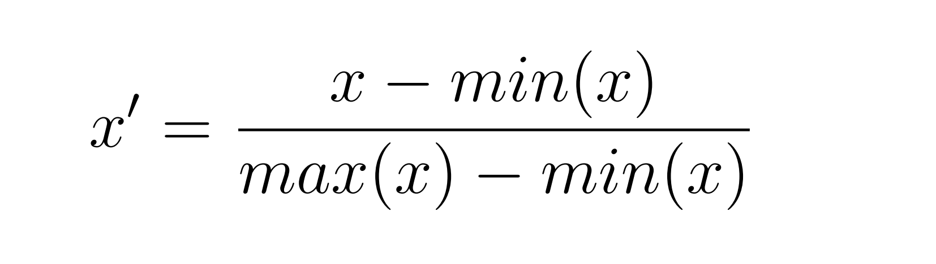
NORMALIZATION
The features are transformed in other ones, in order to obtain the same range of values [0,1] for every column. The method chosen is the min-max normalization:

Slide 7
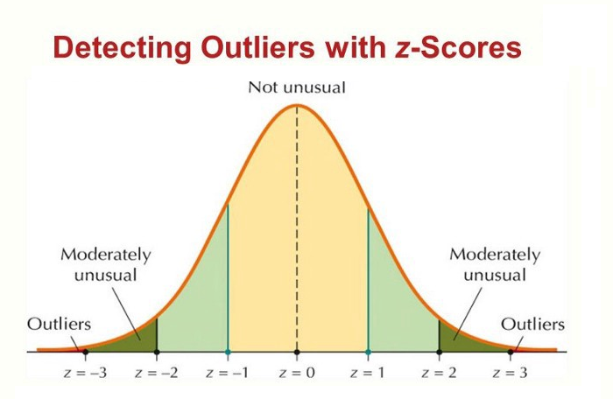
OUTLIERS MANAGEMENT
Outliers are unusual values in the dataset that can distort our analysis and consequently our predictions.
The method used to find outliers is the z-score.
Used Value: 3
Result: 88 removed samples

Slide 8
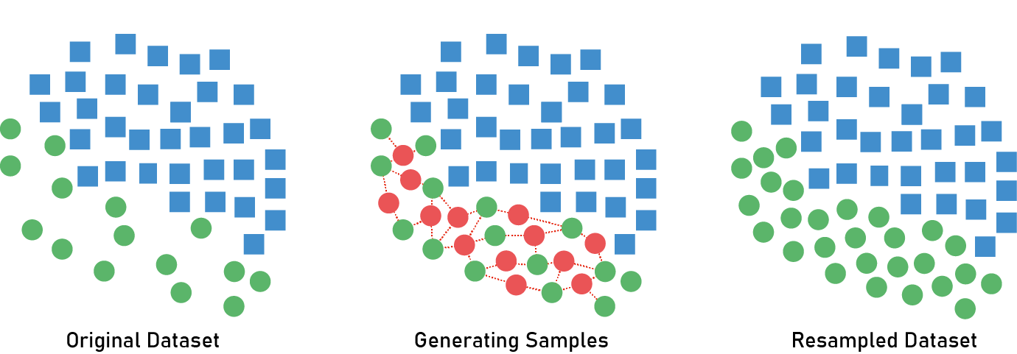
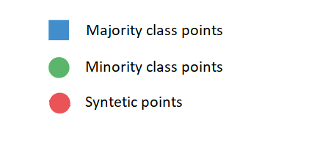
OVERSAMPLING TECHNIQUE - SMOTE
Given an unbalanced dataset with two classes. Synthetic Minority Over-sampling Technique works:
selects the minority class samples
creates new samples as a combination of the first point and his k neighbors on the high-dimensional lines that connect them.

Slide 9
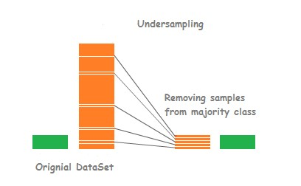
UNDERSAMPLING TECHNIQUE - CLUSTER CENTROID
The most popular technique to apply undersampling is based on cluster centroid.
Starting from the majority classes, we compute the centroid
Remove those samples that are far from the centroid until the dataset is balanced.

Slide 10
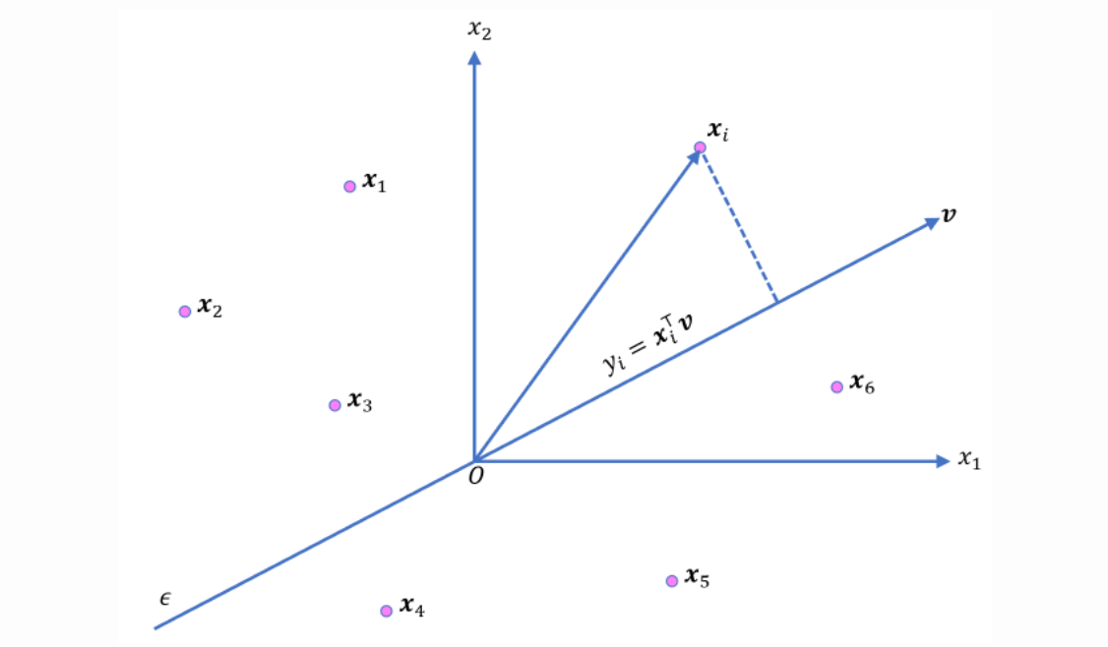
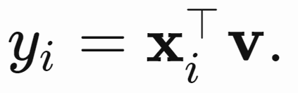
PRINCIPAL COMPONENT ANALYSIS (1)
PCA ( principal component analysis), an orthogonal linear transformation that rearranges features such that their number is reduced. The new variables explain most of the variability in the original set.

Slide 11
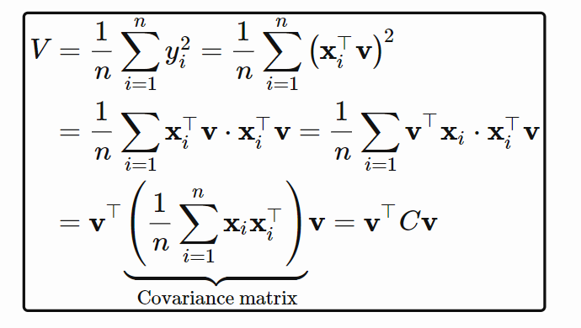
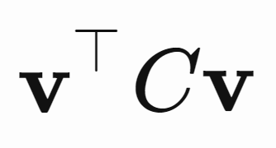
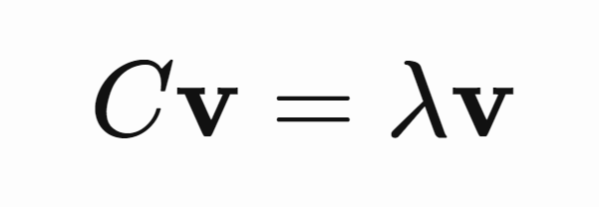
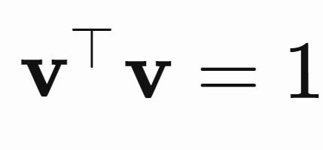
PRINCIPAL COMPONENT ANALYSIS (2)
OPTIMIZATION PROBLEM:
Lagrangian formulation
max
s.t.
OTHER PRINCIPAL COMPONENTS:
Same optimization problem, but we impose the uncorrelation respect to the previous components

Slide 12
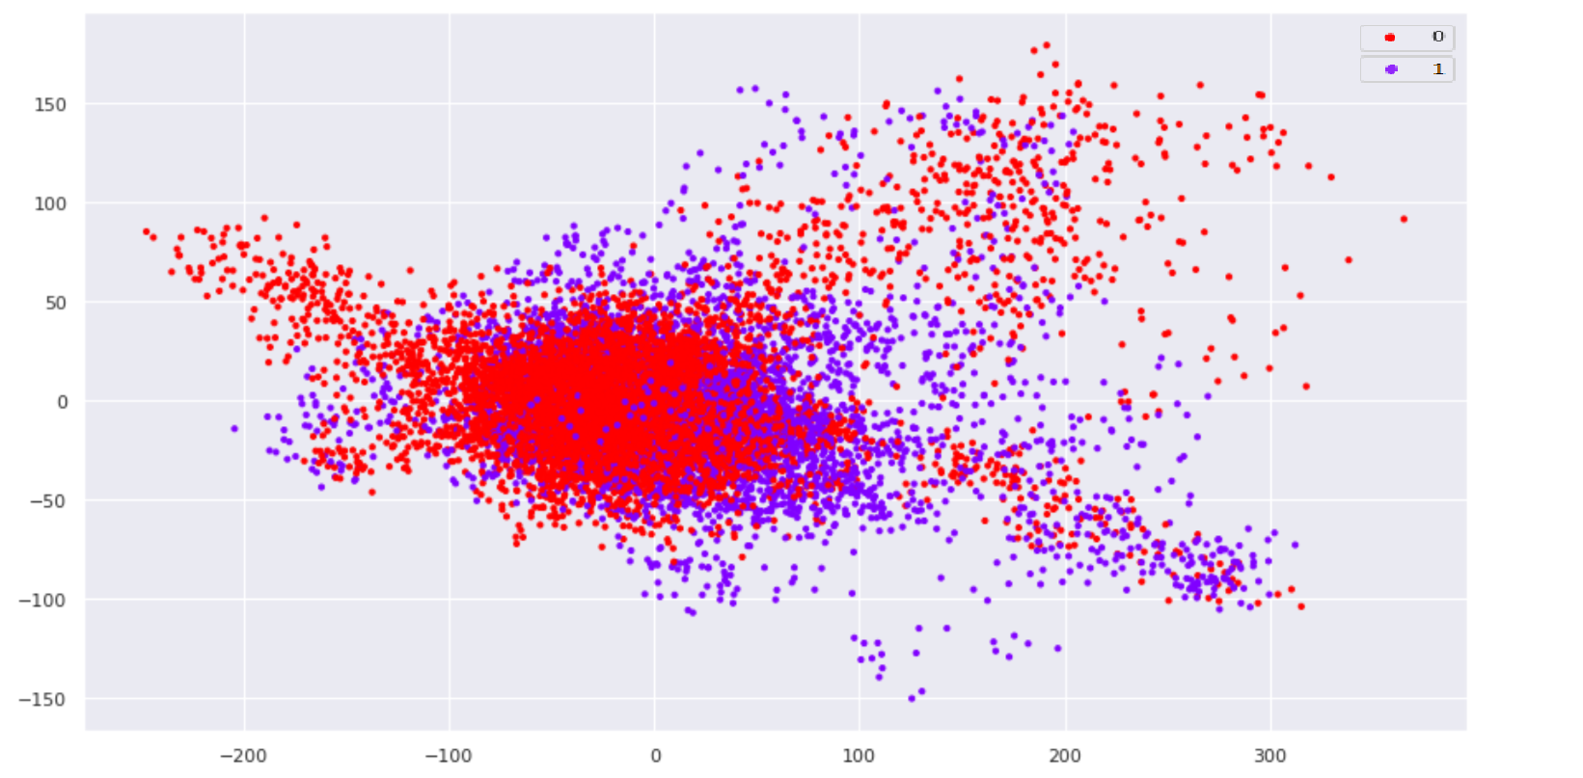
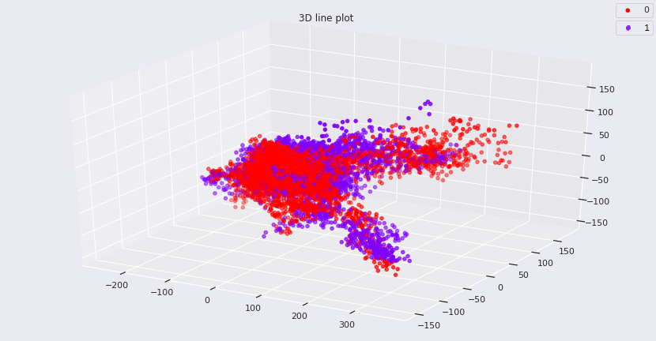
PRINCIPAL COMPONENT ANALYSIS (3)
VISUALIZATION IN 2 PCs:
VISUALIZATION IN 3 PCs:

Slide 13
METHODOLOGY
3

Slide 14
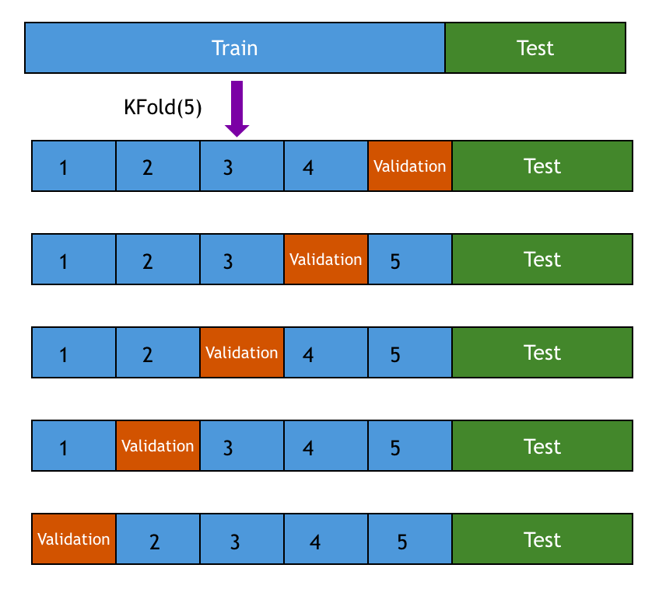
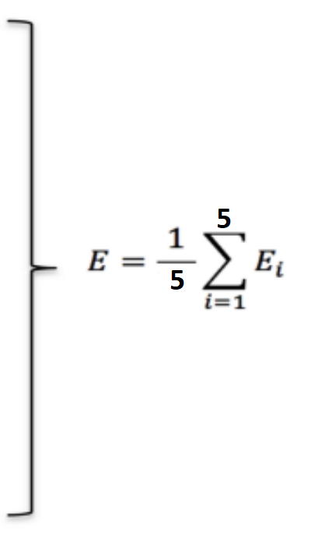
K-FOLD CROSS VALIDATION
KEY STEPS:
Split the training set in k-fold
Use one fold for validating and the remaing ones for training
Compute the error
Repeat for each fold
Average the errors
E1
E2
E3
SETTING:
K=5 is used in hyperparameter tune stage
E4
E5

Slide 15
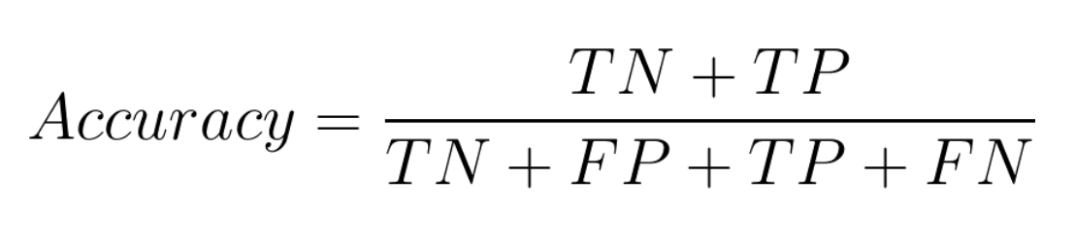
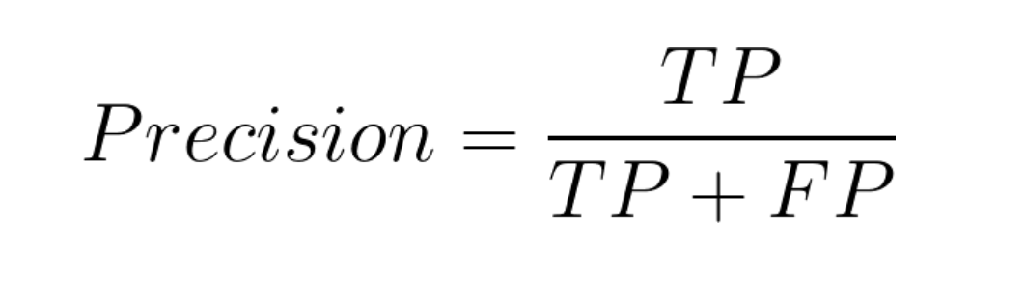
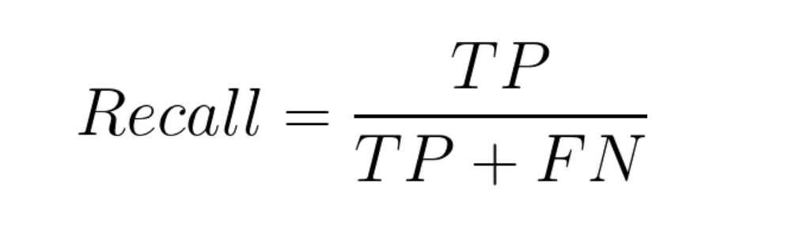
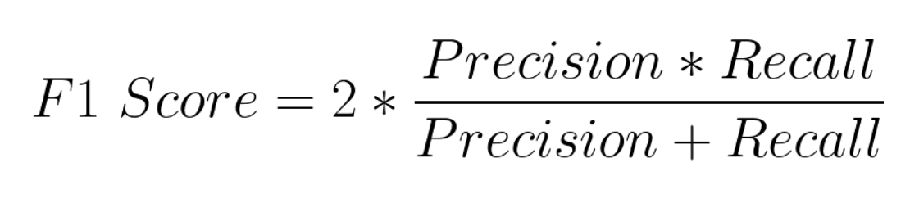
METRICS
Performance metrics are functions that we use in order to measure how well our machine learning methods work. Possible metrics can be:

Slide 16
CLASSIFICATION MODELS
4

Slide 17
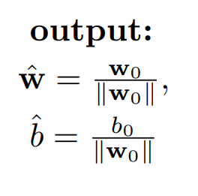
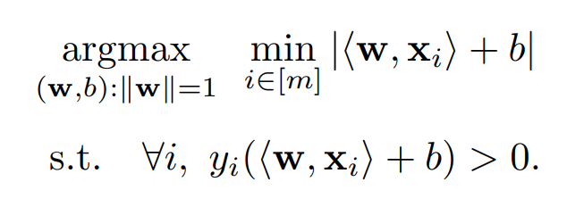
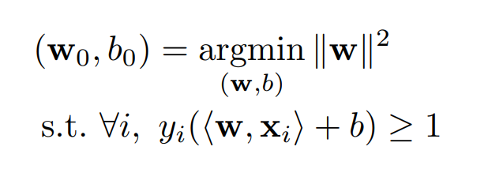
SUPPORT VECTOR MACHINES (1)
The purpose: find the hyperplane that best separates two classes by maximizing the “margin”.
HARD-SVM
Suppose classes are linear separable.
Reformulation
Solution

Slide 18
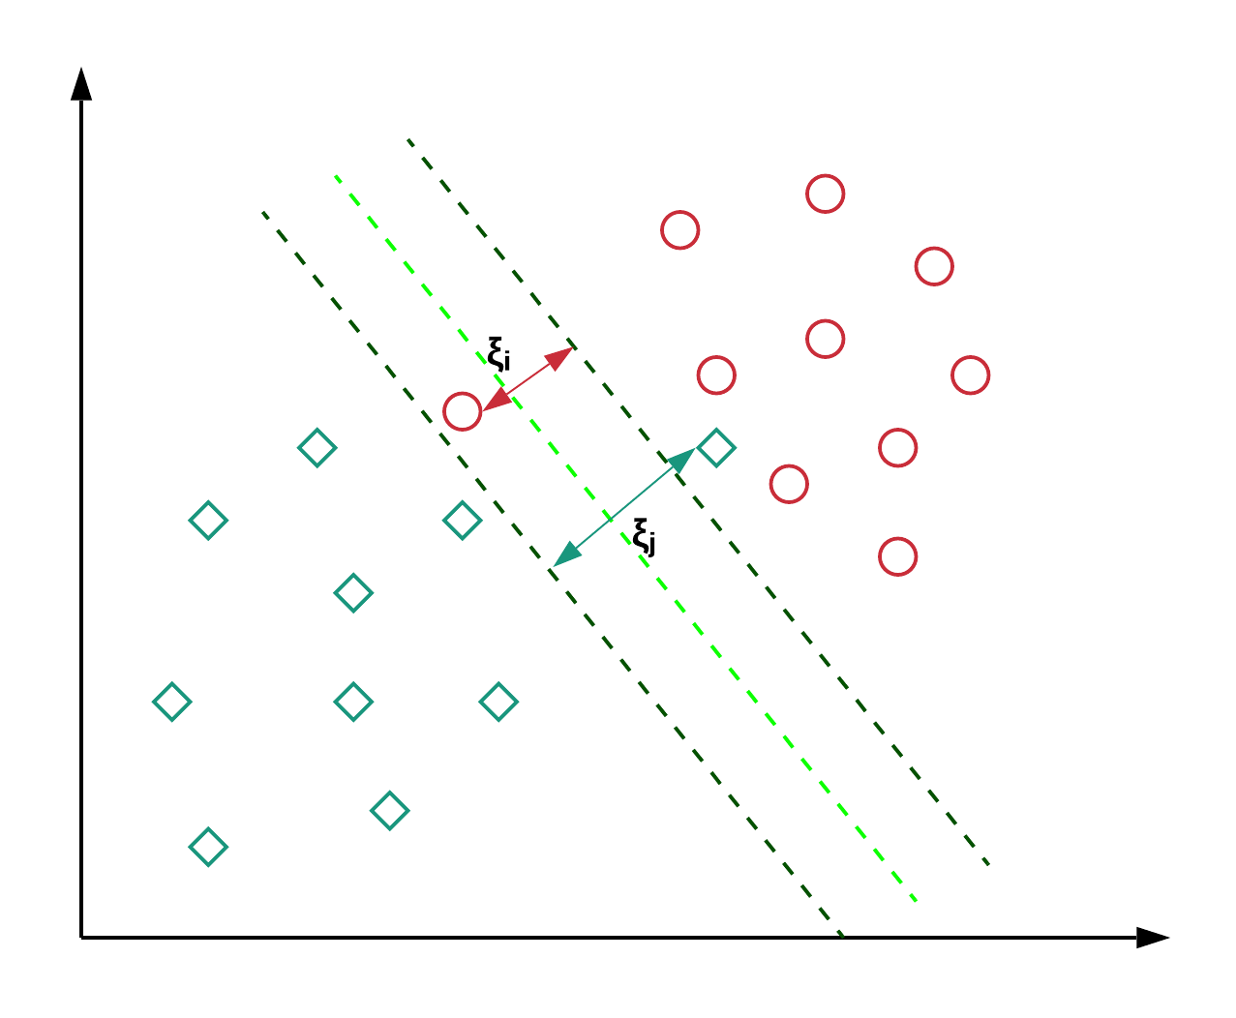
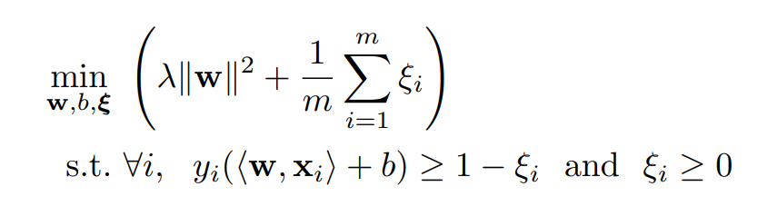

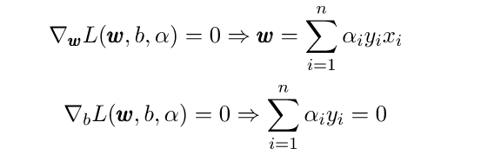

SUPPORT VECTOR MACHINES (2)
SOFT-SVM
Relax the constraint of linear separability
LAGRANGIAN FORMULATION OF SVM
Solve
Replacing

Slide 19
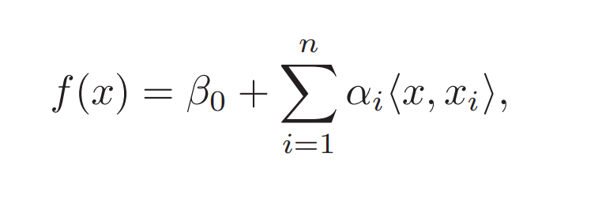
SUPPORT VECTOR MACHINES (3)
SVM WITH KERNEL
The linear support vector classifier can be represented as:
Generalization
𝐾(𝒙, 𝒙′) = 〈𝜓(𝒙), 𝜓(𝒙′)〉.
K is a kernel function that quantifies the similarity of two observations.
Linear kernel: simply inner product
Alpha is non-zero only for support vectors.

Slide 20
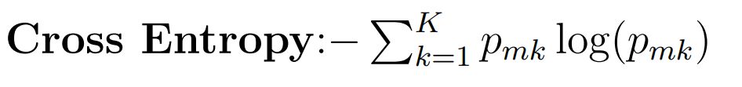
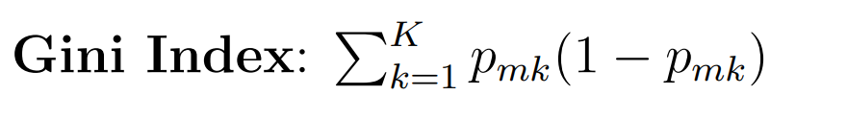
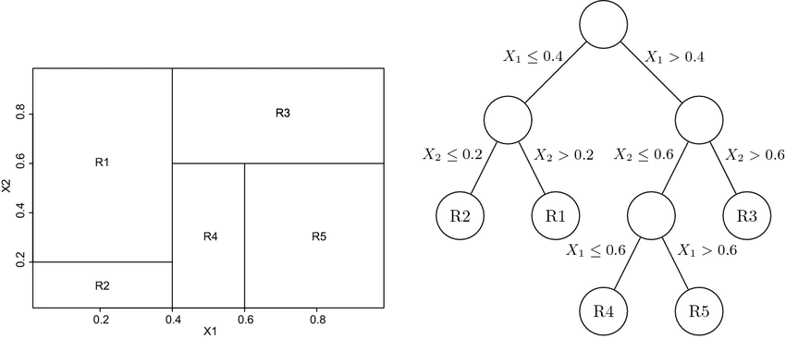
DECISION TREE
The purpose: predict the class or value based on a set of decision rules inferred from training data.
Optimization problem: identify for each node the variable and the cut value to minimize the metric.
Metrics to measure the impurity:

Slide 21
RANDOM FOREST
PROBLEM
Decision tree suffers of high variance
IDEA
Given a set of n independent observations Z1, . . . , Zn, each with variance σ^2, the variance of the mean Z of the observations is given by (σ^2)/n.
SOLUTION
Training a large number of trees and average the results.
For each split, it is considered only a subset of predictors.
This implies the decorrelation.

Slide 22
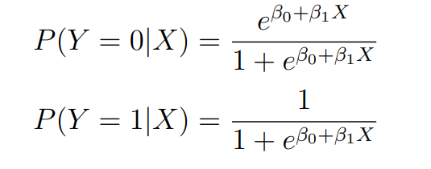
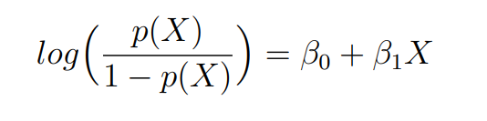
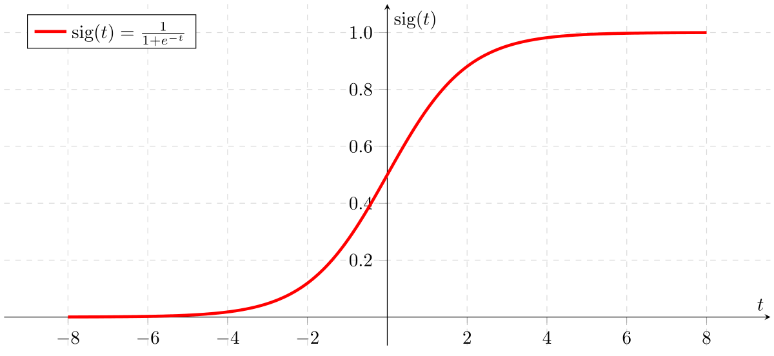
LOGISTIC REGRESSION
We want to map our result to [0,1] range as probability.
The used function is logistic:

Slide 23
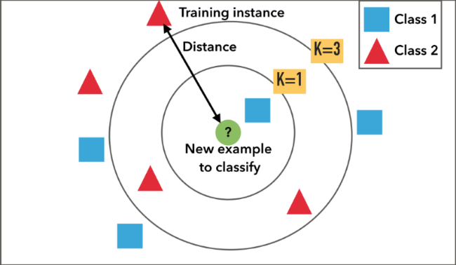
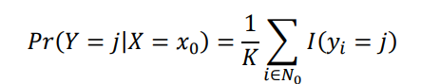
K-NEAREST NEIGHBORS
IDEA
The features are relevant to determine the sample label, thus a close-by sample(means similar features) likely to have the same label.
KEY STEPS
Set k and given an x observation.
Compute the distance among training samples
Order training samples according to their distance
Take the first k samples
Assign to the observation the the class with the highest estimated probability:

Slide 24
CONCLUSION
5

Slide 25
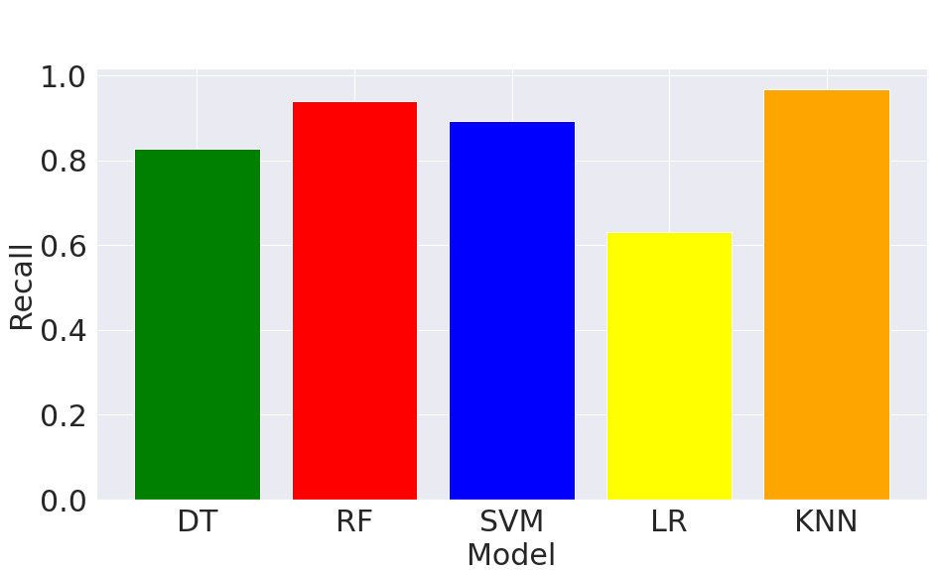

MODEL PERFORMANCES
The best models are the Random Forest with 0.933 f1 score and the K-nearest neighbors with 0.96 f1 score.
The worst model is the Logistic Regressor with 0.63 f1 score. The precision and recall for each model:

Slide 26
THANKS YOU FOR YOUR ATTENTION

